Slide 1










Main
Txt
Color
2019 SUMMER K-SW
AgIOT By Prof. Tony Smith
AgroSitter
Purdue Univ
SUKRYUL LIM, CHANGHO SEO, YUNCHANG CHAE Kyungpook Univ.
SUMIN LEE Sejong Univ.
CHANHYEOK JUN Jeju Univ.
AIDAN MAIS Purdue Univ.
Notes:
임석렬 파이팅!ㅋㅋㅋㅋㅋㅋㅋㅋㅋㅋ

Slide 2


2019 SUMMER K-SW
AgIOT By Prof. Tony Smith
INDEX
Introduction
Evaluation
&Conclusion
Research
Future work
Design
&Development
Reference
Main
Txt
Test
Q&A
Color

Slide 3





Team Members
SUMIN LEE
CHANGHO SEO
YUNCHANG CHAE
CHANHYEOK JUN
SUKRYUL LIM

Slide 4


Introduction
Evaluation
Research
Conclusion
33.867cm : 19.05cm
Design
Future work
Reference
Development
n
Introduction
Introduction
Research
Design
&Development
Test
Evaluation
&Conclusion
Future Work
Reference
“Farmers in Indiana must deal with a huge amount of workload”
Main
Txt
“the climate of Indiana is very changeable across
the field in scales of just a couple acres”
Color

Slide 5
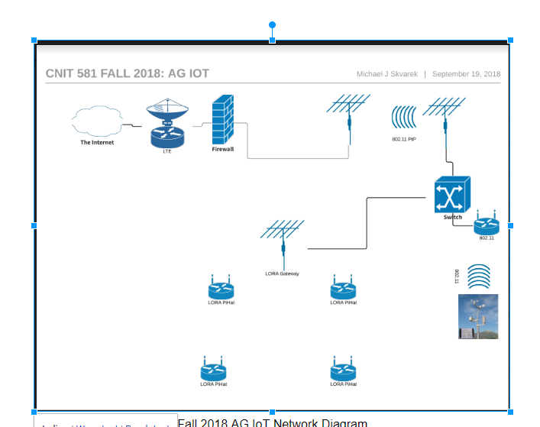
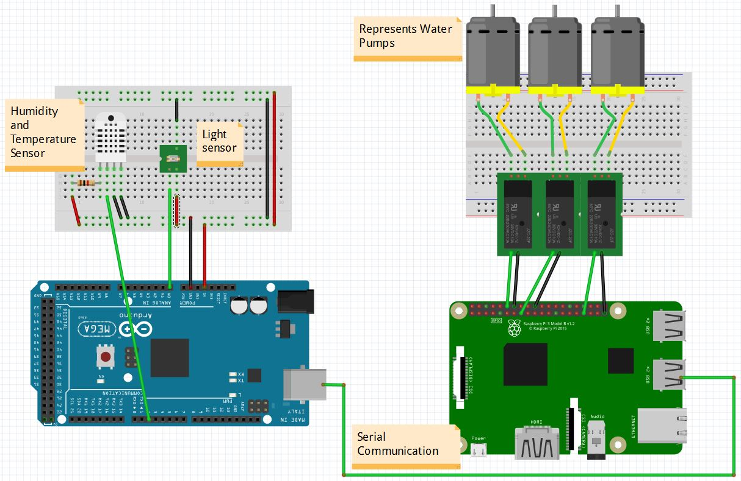
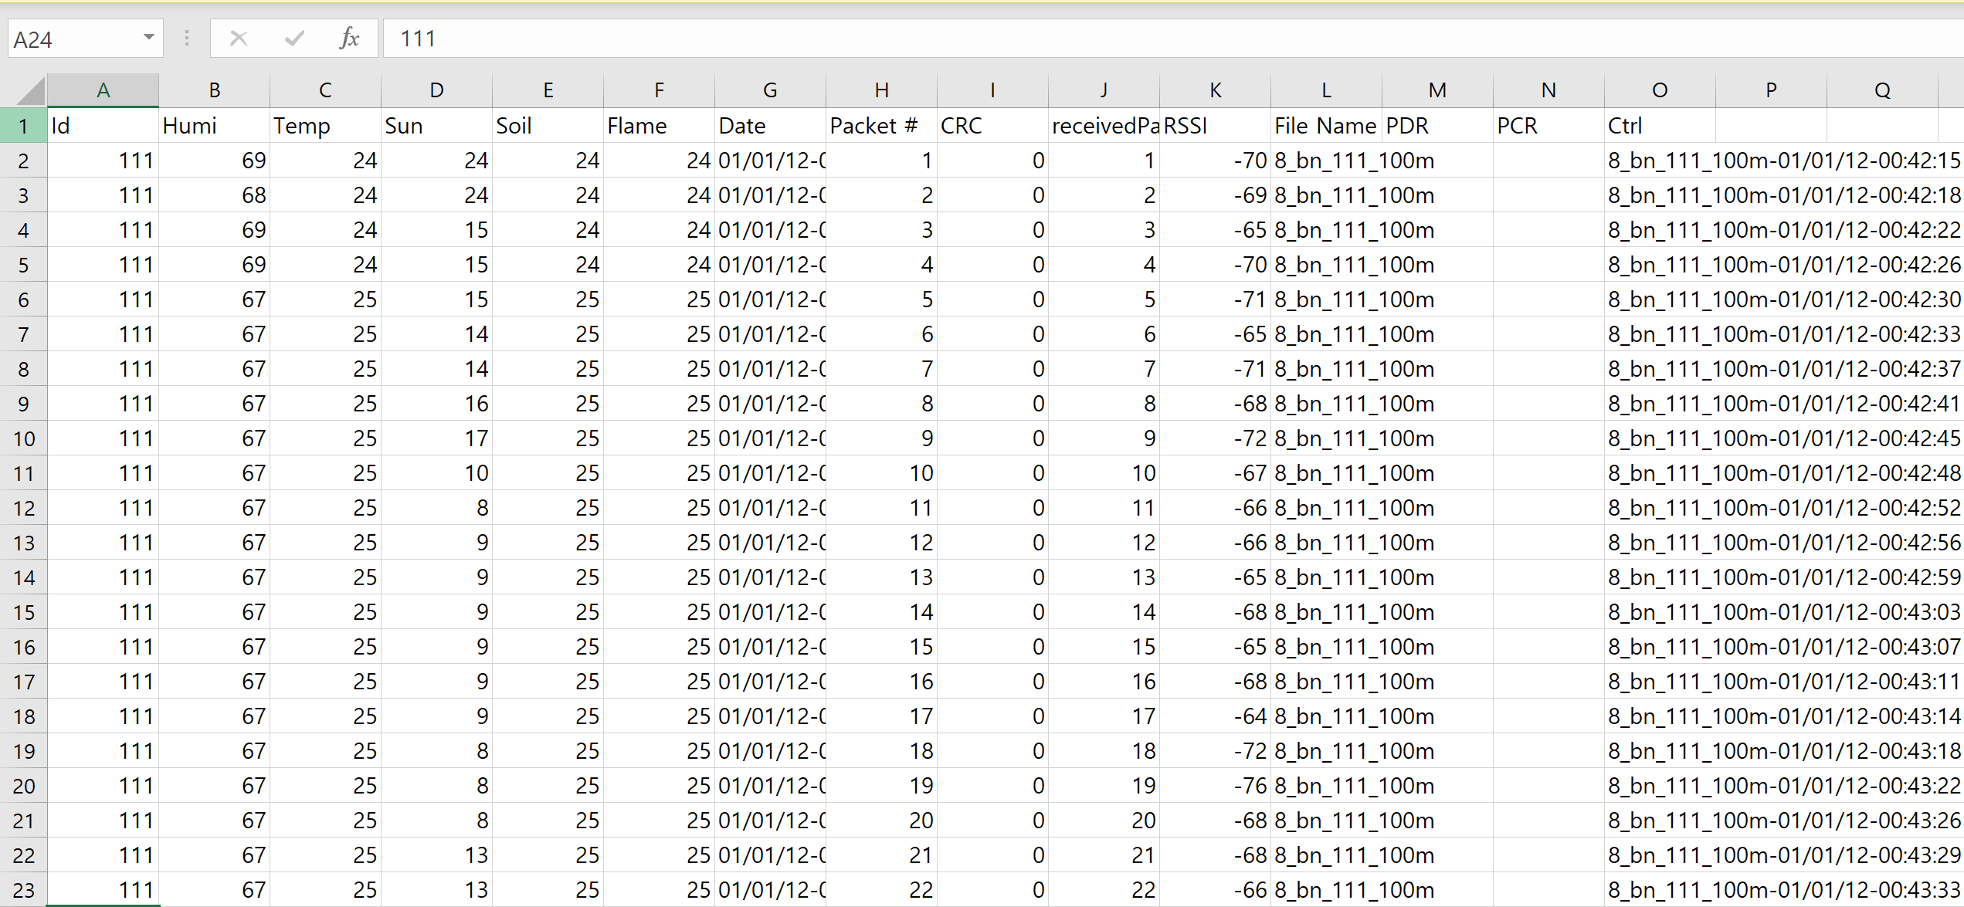
Introduction
Research
Conclusion
33.867cm : 19.05cm
Design
Future work
Development
Reference
n
Previous Project
Introduction
Research
Design
&Development
Test
“LoRa Network
Does not work”
Evaluation
&Conclusion
Future Work
Reference
Main
Txt
Color
나오며

Slide 6




Project Goal
Main
Txt
APRS
(Automatic Packet Reporting System)
“Adequate Network for Agricultural IoT”
Color

Slide 7
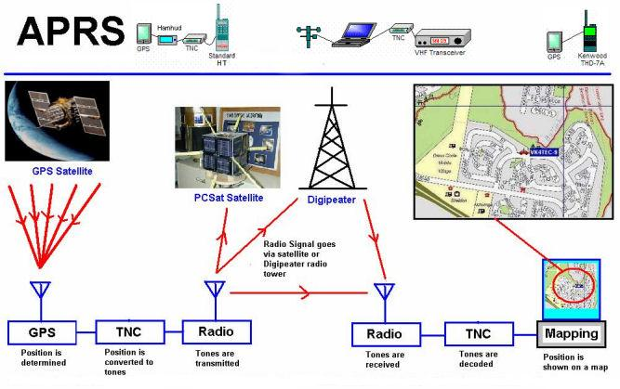
Introduction
Evaluation
Research
Conclusion
33.867cm : 19.05cm
Design
Future work
Development
Reference
n
APRS Research
Introduction
Research
Design
&Development
Test
Evaluation
&Conclusion
Future Work
Reference
Main
Txt
Color
나오며

Slide 8
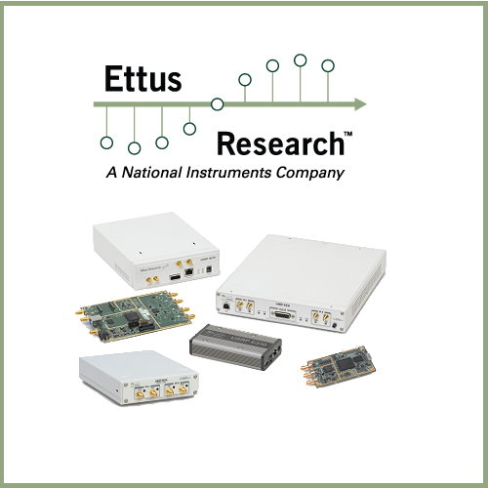
Introduction
Evaluation
Research
Conclusion
33.867cm : 19.05cm
Design
Future work
Development
Reference
n
SDR
Introduction
Research
Design
&Development
Test
Evaluation
&Conclusion
Future Work
Reference
Main
Txt
Color
나오며

Slide 9
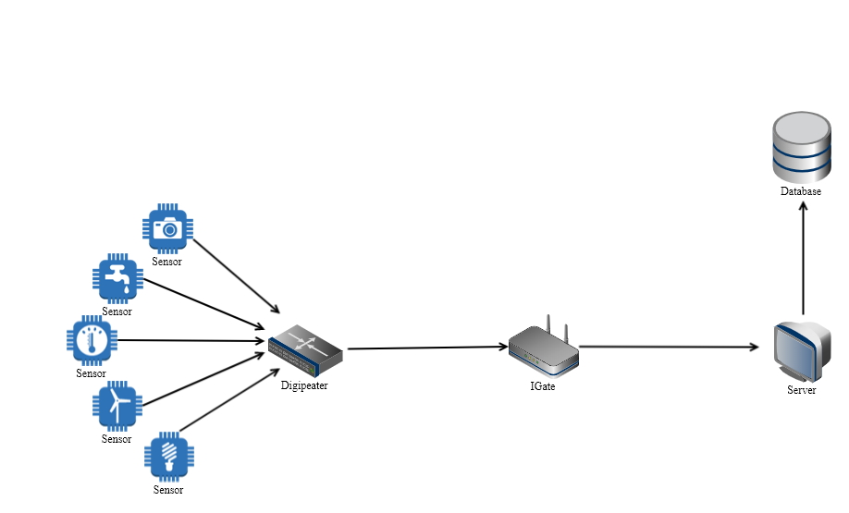
Introduction
Evaluation
Research
Conclusion
33.867cm : 19.05cm
Design
Future work
Development
Reference
n
Network Diagram
Introduction
Research
Design
&Development
Test
Evaluation
&Conclusion
Future Work
Reference
Main
Txt
Color
나오며

Slide 10
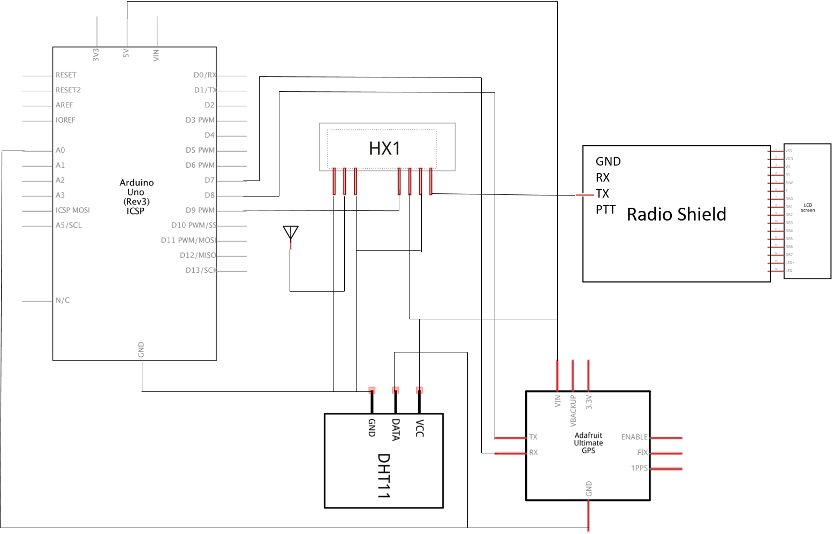
Introduction
Evaluation
Research
Conclusion
33.867cm : 19.05cm
Design
Future work
Development
Reference
n
Circuit Board
Introduction
Research
Design
&Development
Test
Evaluation
&Conclusion
Future Work
Reference
Main
Txt
Color
나오며

Slide 11
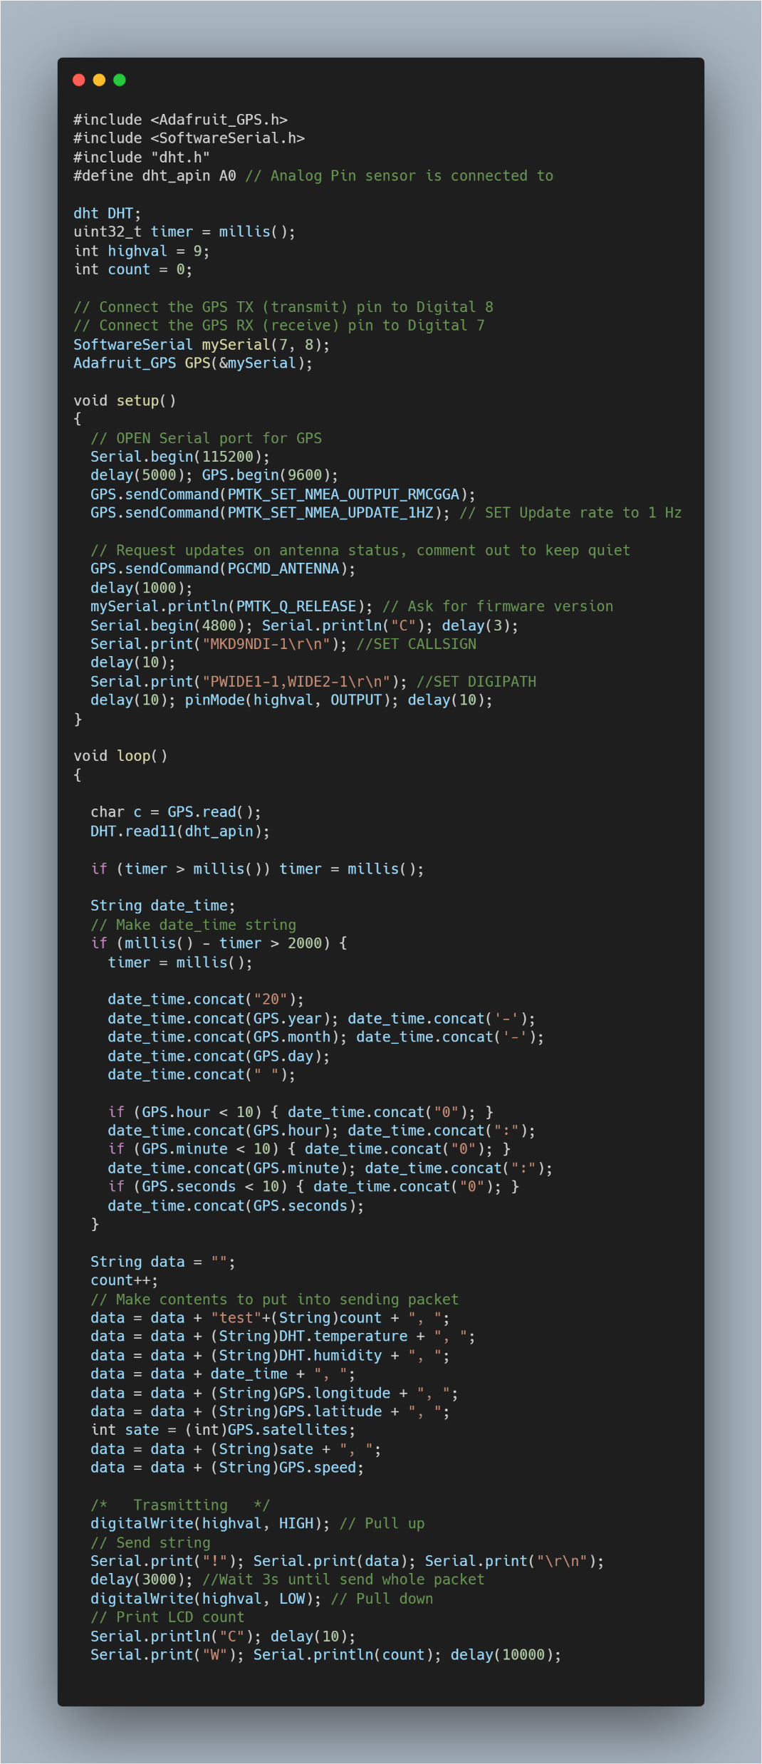
Introduction
Evaluation
Research
Conclusion
33.867cm : 19.05cm
Design
Future work
Development
Reference
n
Arduino Code
Introduction
Research
Design
&Development
Test
Evaluation
&Conclusion
Future Work
Reference
Main
Txt
Color
나오며

Slide 12
Introduction
Evaluation
Research
Conclusion
33.867cm : 19.05cm
Design
Future work
Development
Reference
n
Arduino Code
Introduction
Research
Design
&Development
Test
Evaluation
&Conclusion
Future Work
Reference
Main
Txt
Color
나오며

Slide 13

Introduction
Evaluation
Research
Conclusion
33.867cm : 19.05cm
Design
Future work
Development
Reference
n
Arduino Code
Introduction
Research
Design
&Development
Test
Evaluation
&Conclusion
Future Work
Reference
Main
Txt
Color
나오며

Slide 14
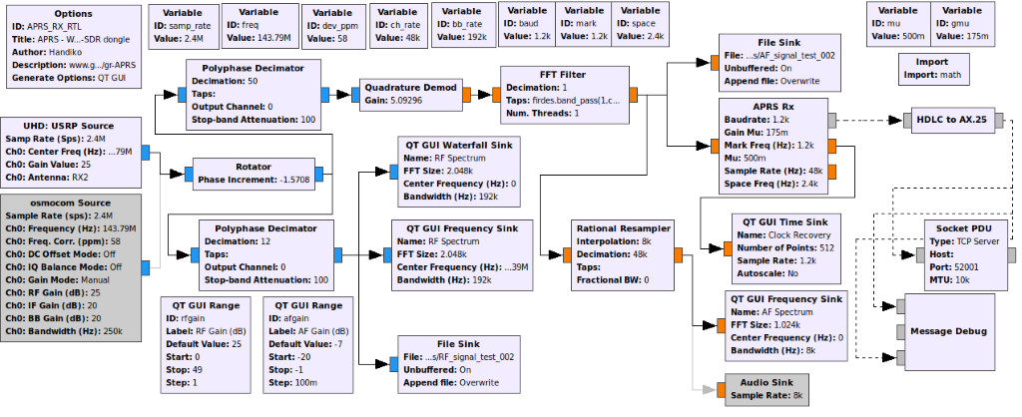
Introduction
Evaluation
Research
Conclusion
33.867cm : 19.05cm
Design
Future work
Development
Reference
n
SDR Flow Chart
Introduction
Research
Design
&Development
Test
Evaluation
&Conclusion
Future Work
Reference
Main
Txt
Color
나오며

Slide 15
Introduction
Evaluation
Research
Conclusion
33.867cm : 19.05cm
Design
Future work
Development
Reference
n
SDR Flow Chart
Introduction
Research
Design
&Development
Test
Evaluation
&Conclusion
Future Work
Reference
Main
Txt
Color
나오며

Slide 16
Introduction
Evaluation
Research
Conclusion
33.867cm : 19.05cm
Design
Future work
Development
Reference
n
SDR Flow Chart
Introduction
Research
Design
&Development
Test
Evaluation
&Conclusion
Future Work
Reference
Main
Txt
Color
나오며

Slide 17
Introduction
Evaluation
Research
Conclusion
33.867cm : 19.05cm
Design
Future work
Development
Reference
n
SDR Flow Chart
Introduction
Research
Design
&Development
Test
Evaluation
&Conclusion
Future Work
Reference
Main
Txt
Color
나오며

Slide 18
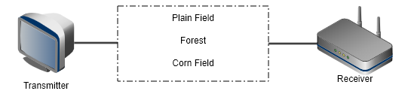
Introduction
Evaluation
Research
Conclusion
33.867cm : 19.05cm
Design
Future work
Development
Reference
n
Test-Availability
Introduction
Research
Design
&Development
Test
Evaluation
&Conclusion
Future Work
Reference
Main
Txt
Color
나오며

Slide 19
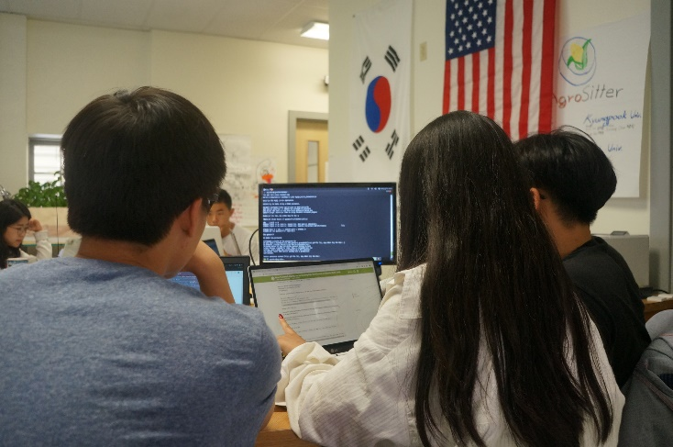
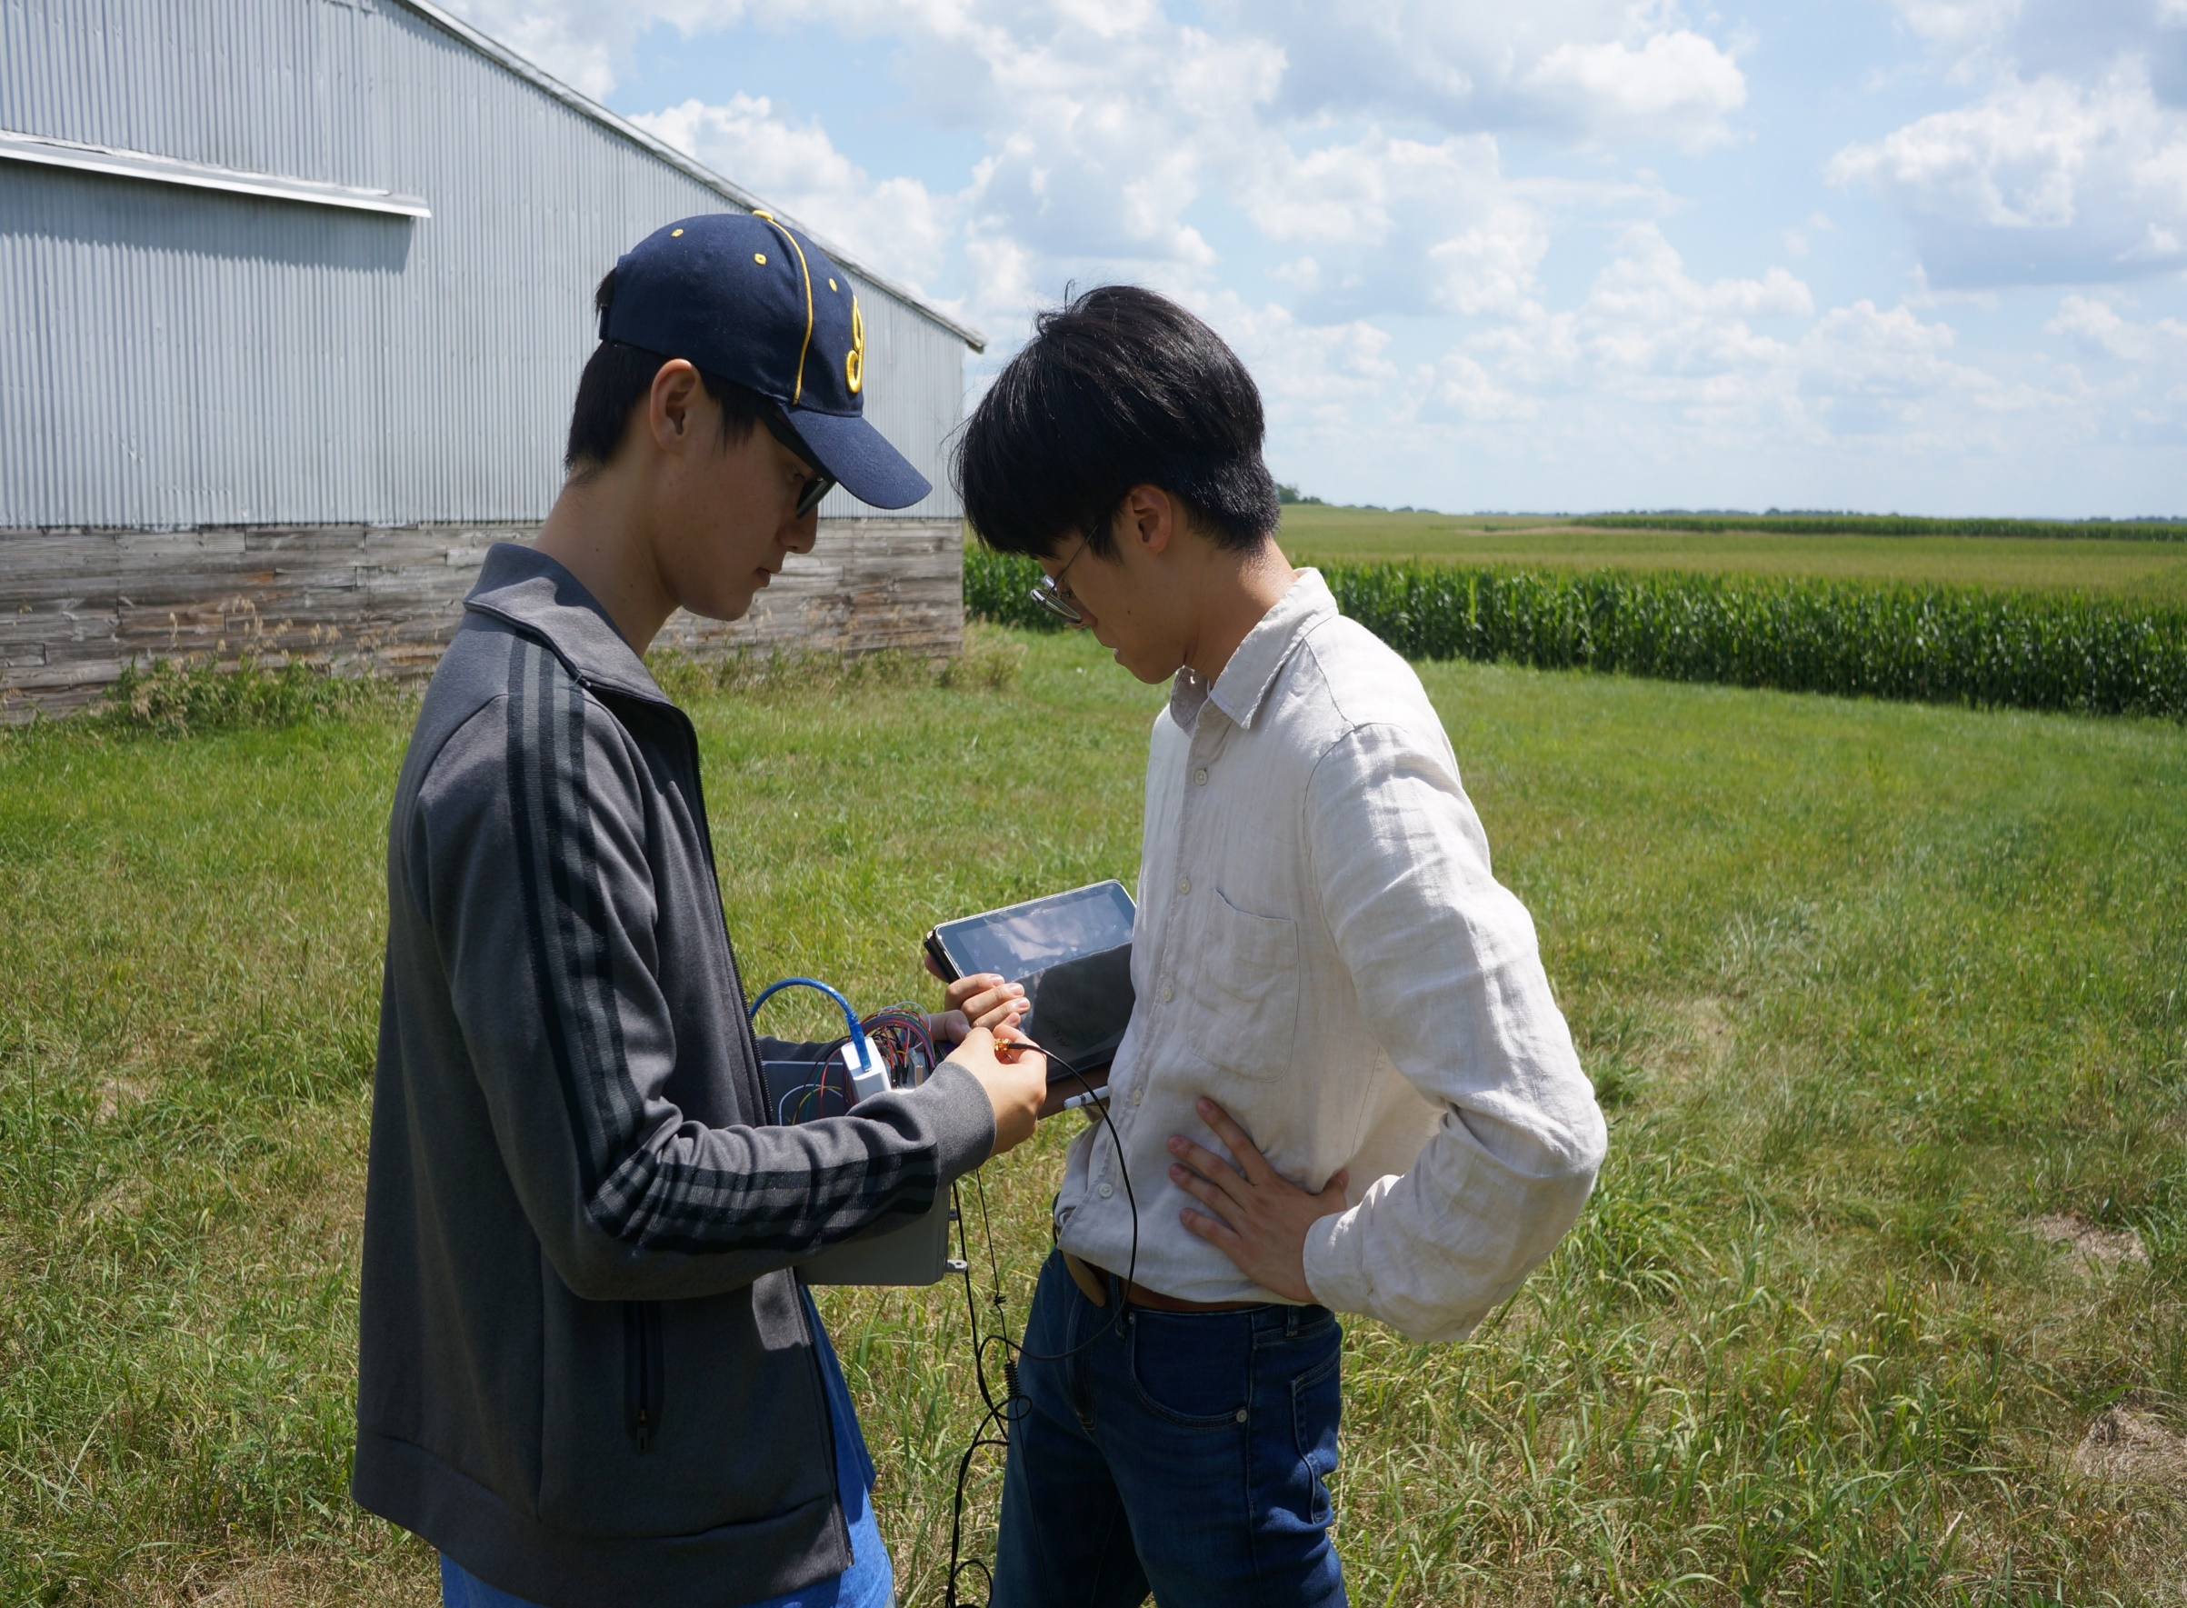
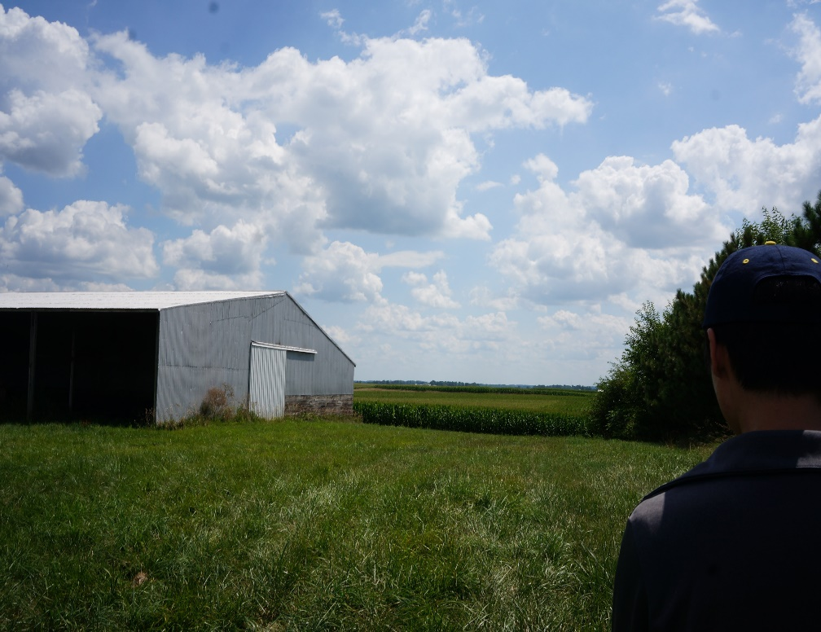
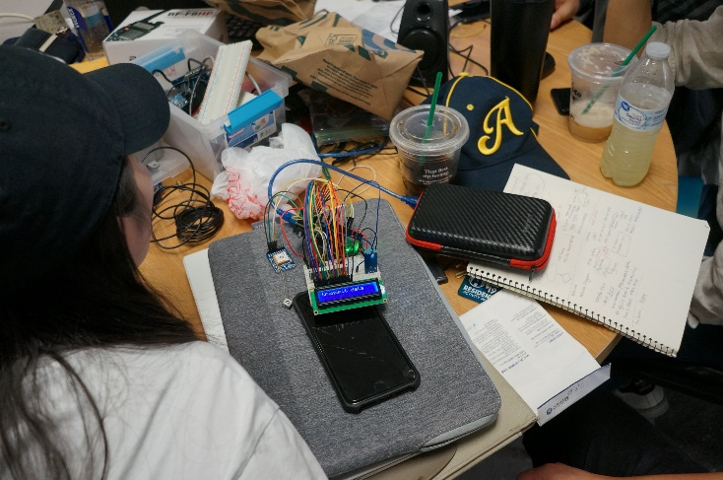
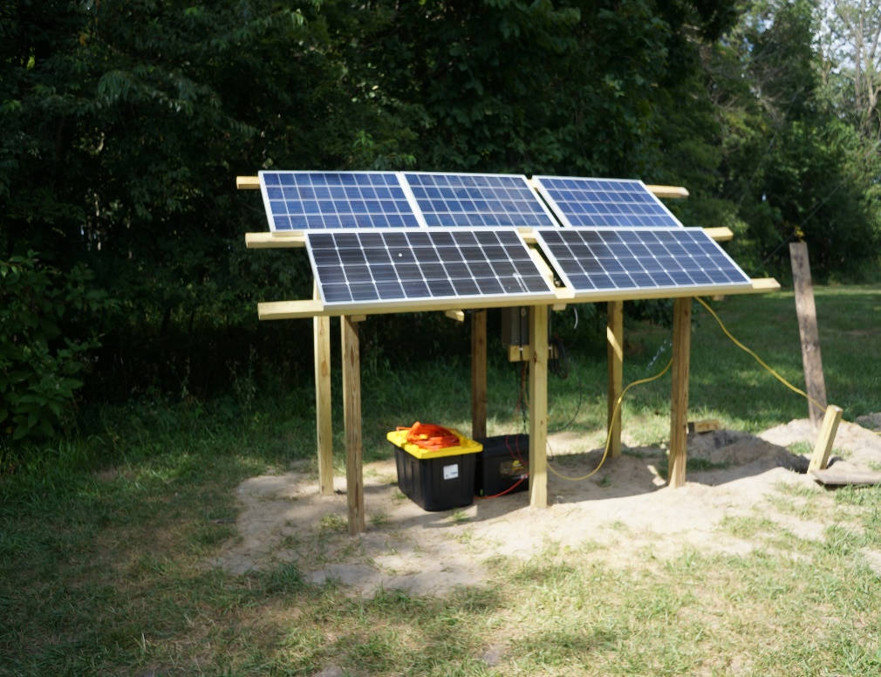
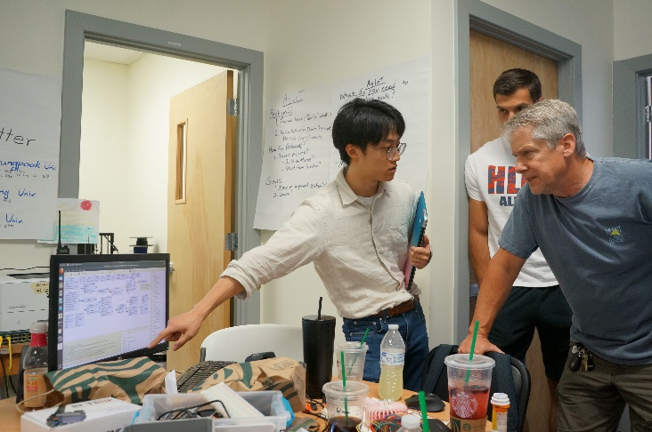
Test-Availability
Main
Txt
Color

Slide 20
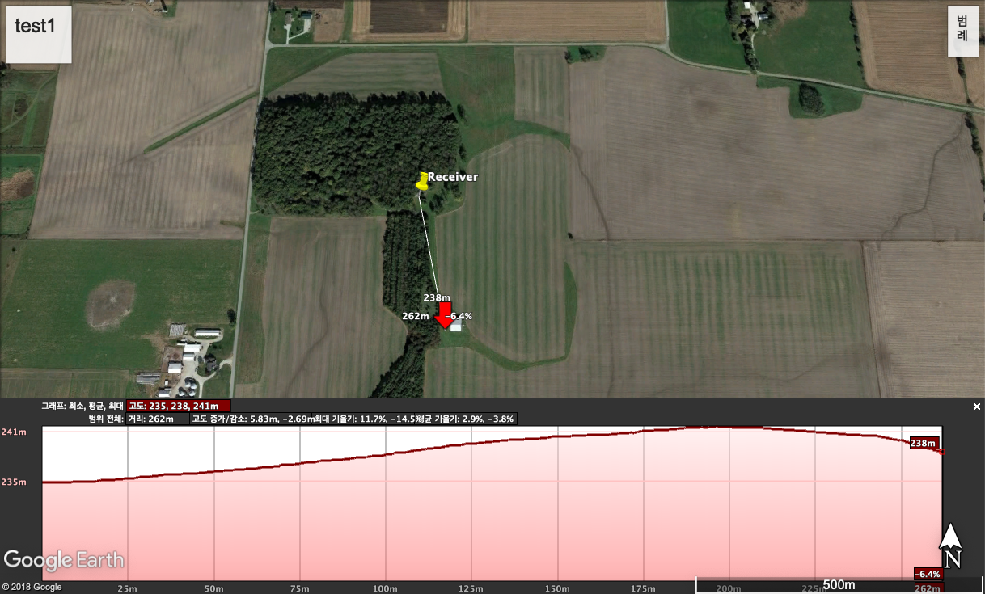
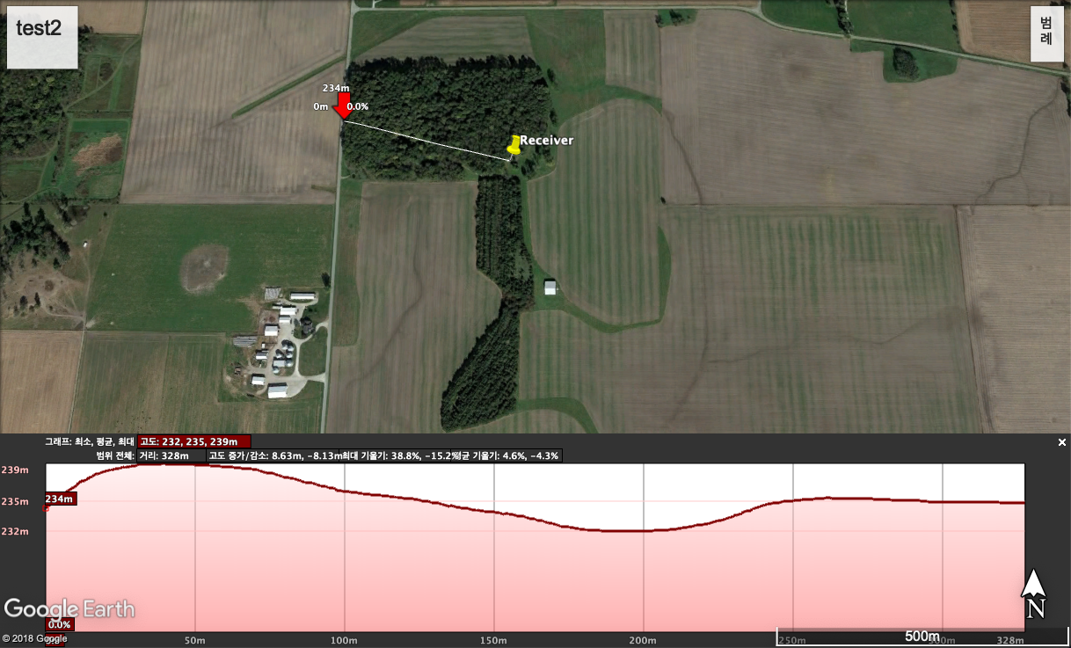
n
Test-Availability
Introduction
Research
Land type: Plane field
Distance: 262m
Elevation Difference: 3m
Tone availability: Available
Design
&Development
Test
Evaluation
&Conclusion
Future Work
Reference
Main
Txt
Land type: Forest
Distance: 328m
Elevation Difference: 1m
Tone availability: Available
Color

Slide 21
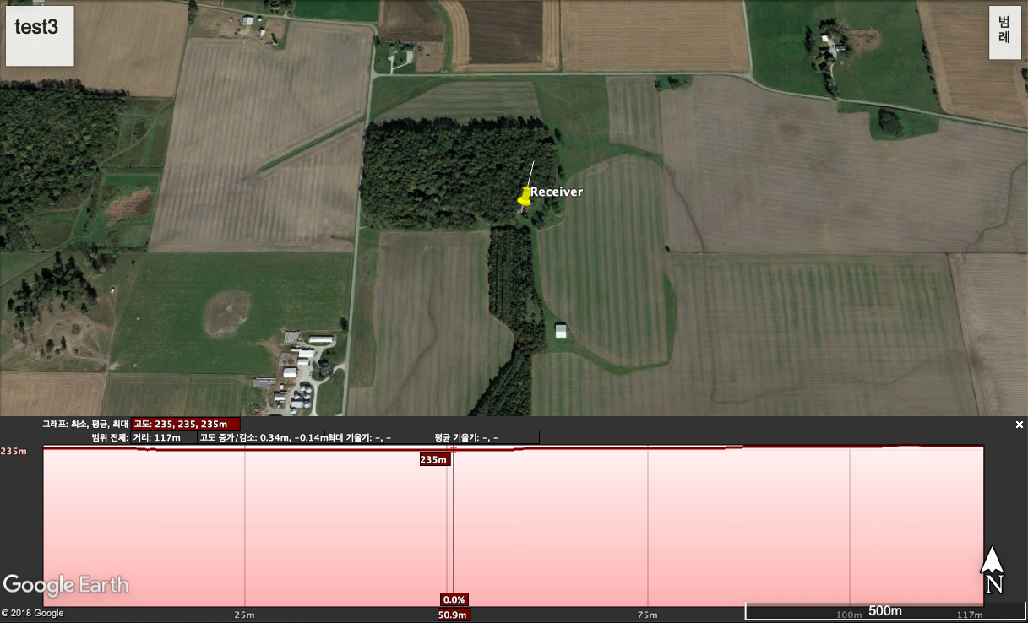
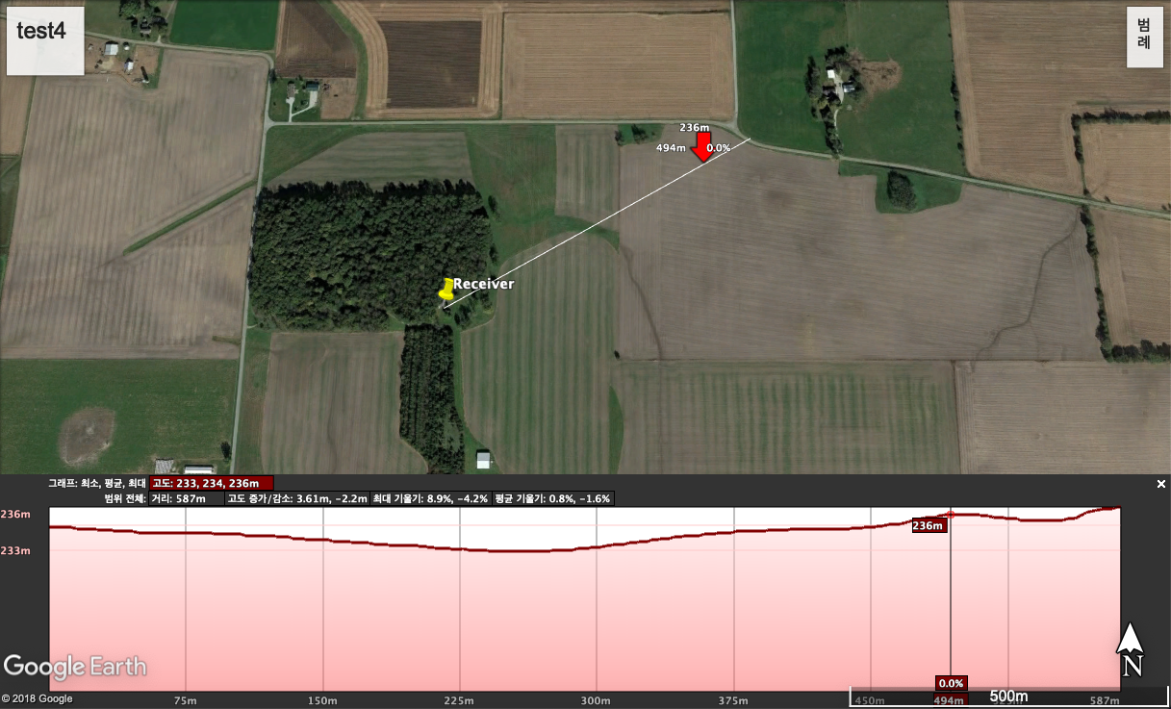
n
Test-Availability
Introduction
Research
Land type: Forest
Distance: 117m
Elevation Difference: 0.34m
Tone availability: Available
Design
&Development
Test
Evaluation
&Conclusion
Future Work
Reference
Main
Txt
Land type: Forest & Corns
Distance: 587m
Elevation Difference: 1m
Tone availability: Available
Color

Slide 22
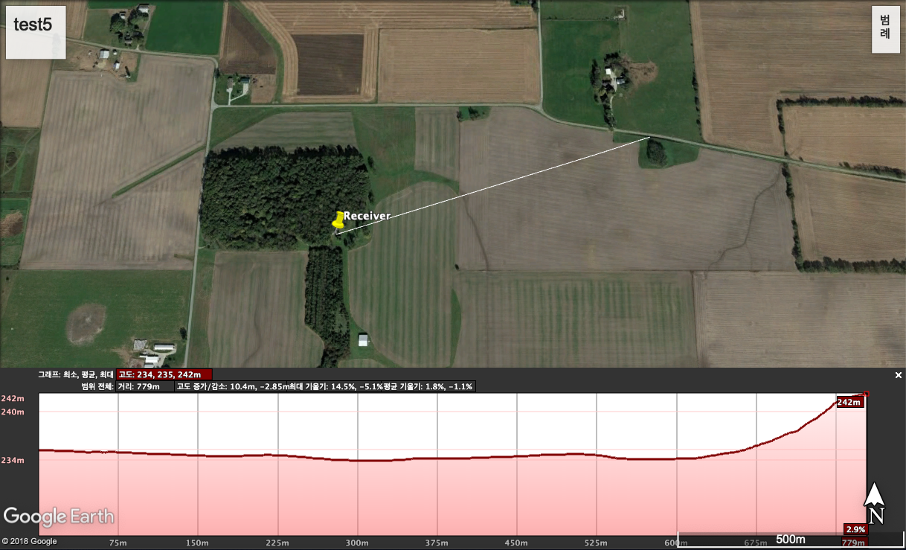
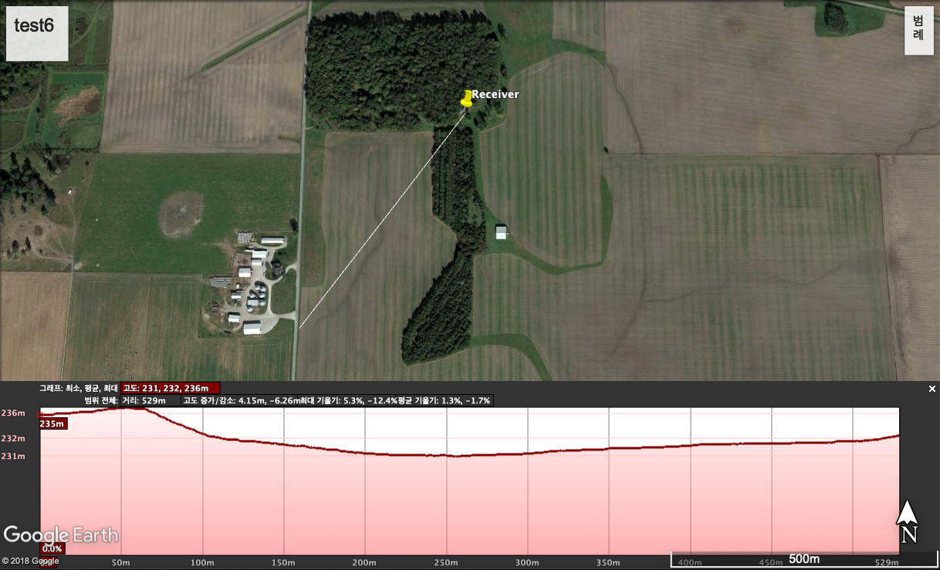
n
Test-Availability
Introduction
Research
Land type: Corns
Distance: 779m
Elevation Difference: 7m
Tone availability: Available
Design
&Development
Test
Evaluation
&Conclusion
Future Work
Reference
Main
Txt
Land type: Forest & Corns
Distance: 529m
Elevation Difference: 2m
Tone availability: Available
Color

Slide 23
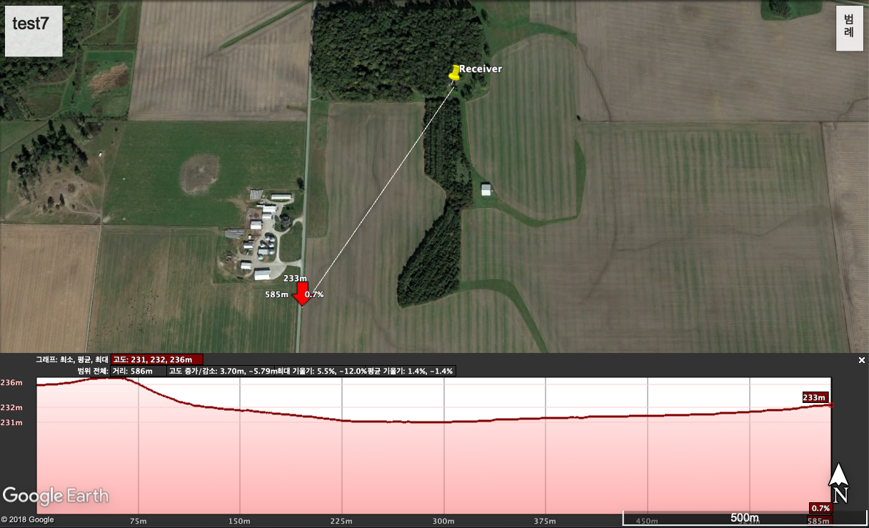
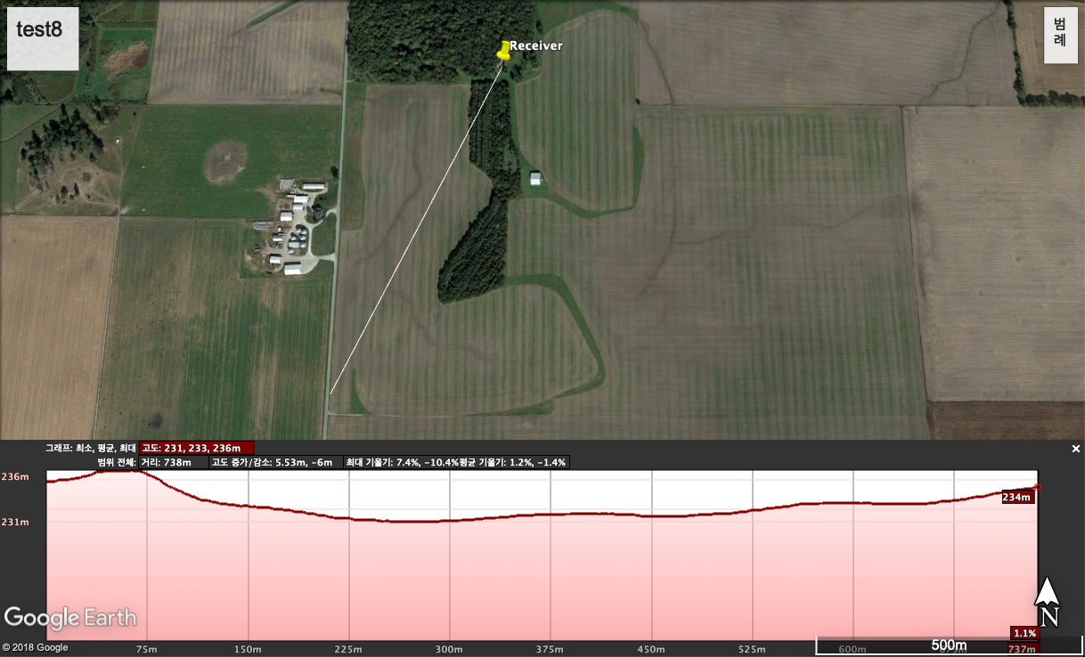
n
Test-Availability
Introduction
Research
Land type: Forest & Corns
Distance: 586m
Elevation Difference: 2m
Tone availability: Available
Design
&Development
Test
Evaluation
&Conclusion
Future Work
Reference
Main
Txt
Land type: Forest & Corns
Distance: 738m
Elevation Difference: 1m
Tone availability: Available
Color

Slide 24
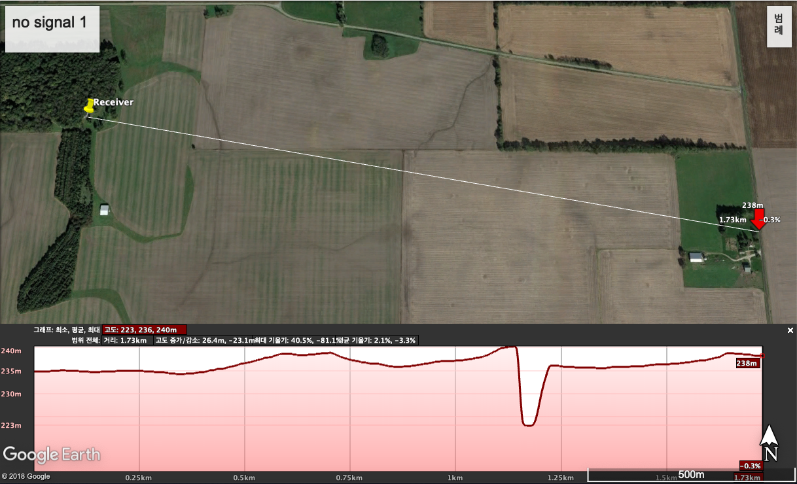
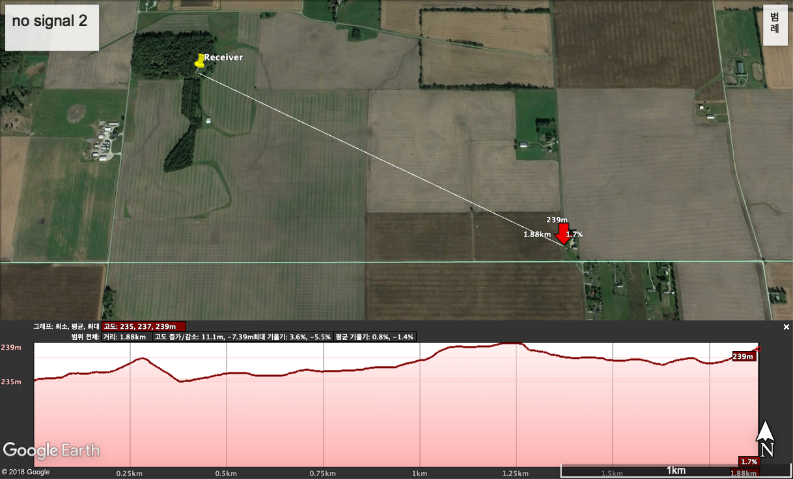
n
Test-Availability
Introduction
Research
Land type: Corns
Distance: 1730m
Elevation Difference: 3m
Tone availability: Not Available
Design
&Development
Test
Evaluation
&Conclusion
Future Work
Reference
Main
Txt
Land type: Corns & plane field
Distance: 1880m
Elevation Difference: 4m
Tone availability: Not Available
Color

Slide 25
n
Test-Availability Evaluation
Introduction
1.
Research
APRS (Radio signal) propagates well
in agricultural environments
Longest distance 779m
Design
&Development
Test
Evaluation
&Conclusion
Future Work
2.
Need to check on data packet, signal strength
Reference
Main
Txt
Color

Slide 26

Introduction
Evaluation
Research
Conclusion
33.867cm : 19.05cm
Design
Future work
Development
Reference
n
Test-Stability
Introduction
Research
Design
&Development
Test
Evaluation
&Conclusion
Future Work
Reference
Main
Txt
Color
나오며

Slide 27
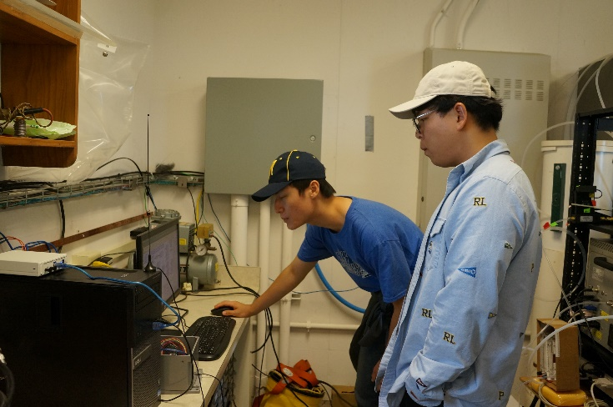
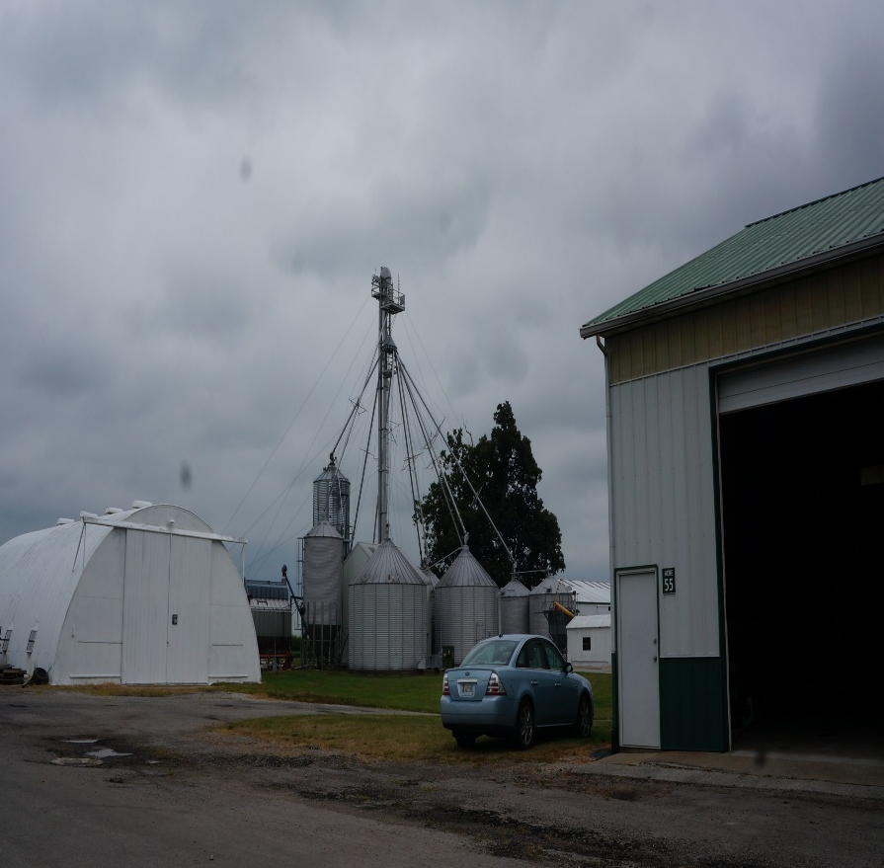
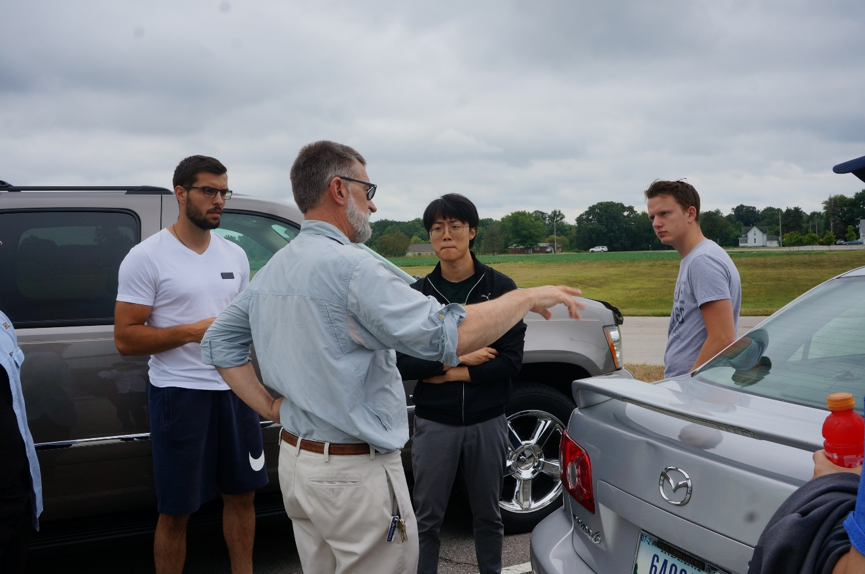
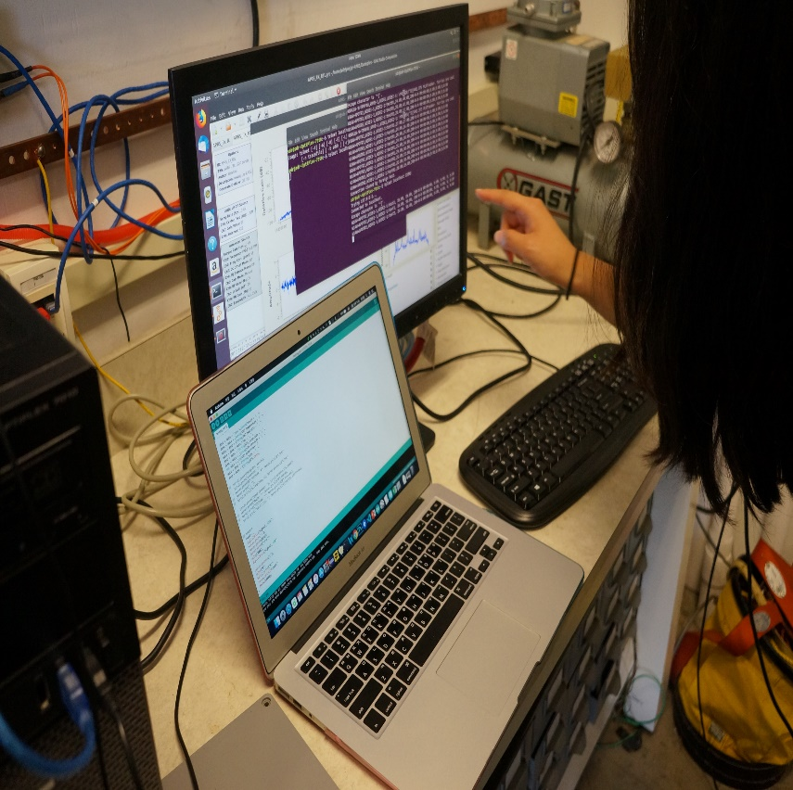
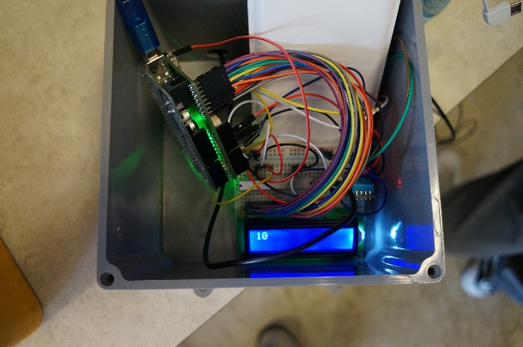
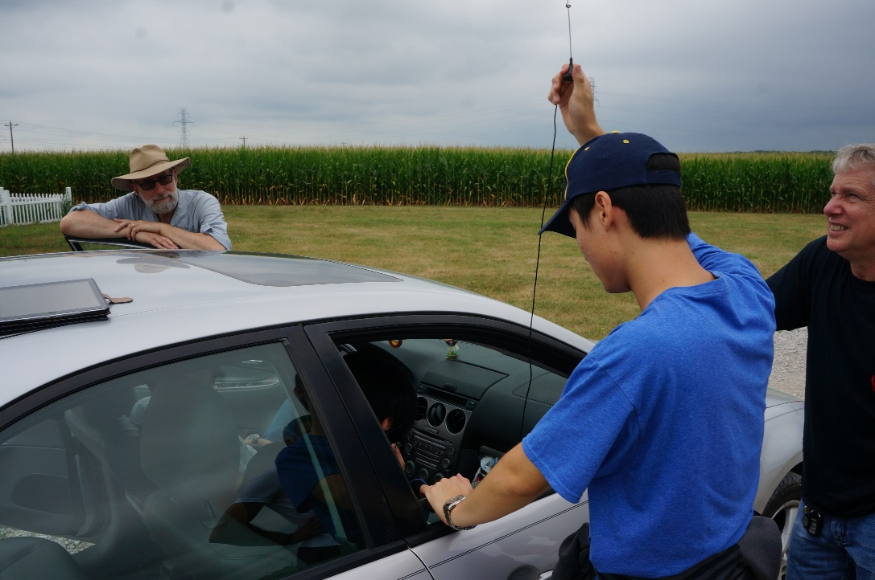

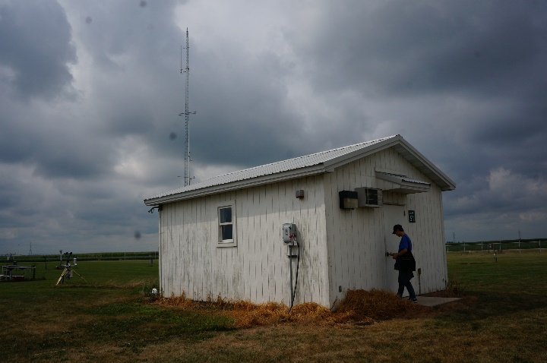
Test-Stability
Main
Txt
Color

Slide 28
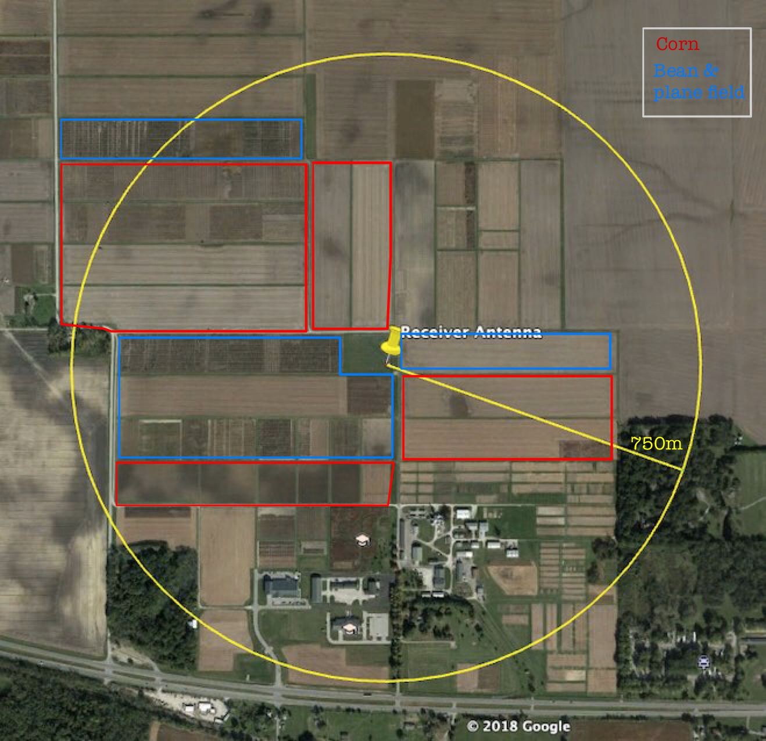
n
Test-Stability
Introduction
Research
Design
&Development
Test
Evaluation
&Conclusion
Future Work
Reference
Main
Txt
Color

Slide 29
Introduction
Research
Conclusion
33.867cm : 19.05cm
Design
Future work
Development
n
Test-Stability
Introduction
Research
Design
&Development
Test
Evaluation
&Conclusion
https://www.youtube.com/watch?v=r7tQECytsyU&feature=youtu.be
Future Work
Reference
Main
Txt
Color
나오며
Notes:
https://www.youtube.com/watch?v=r7tQECytsyU&feature=youtu.be

Slide 30
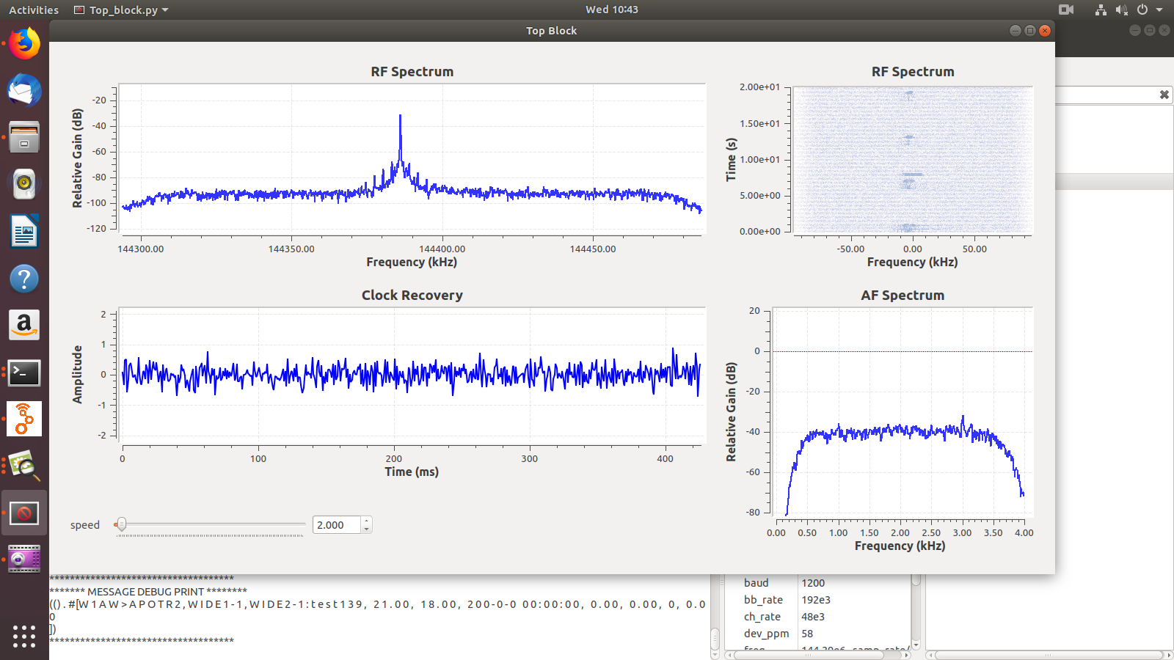
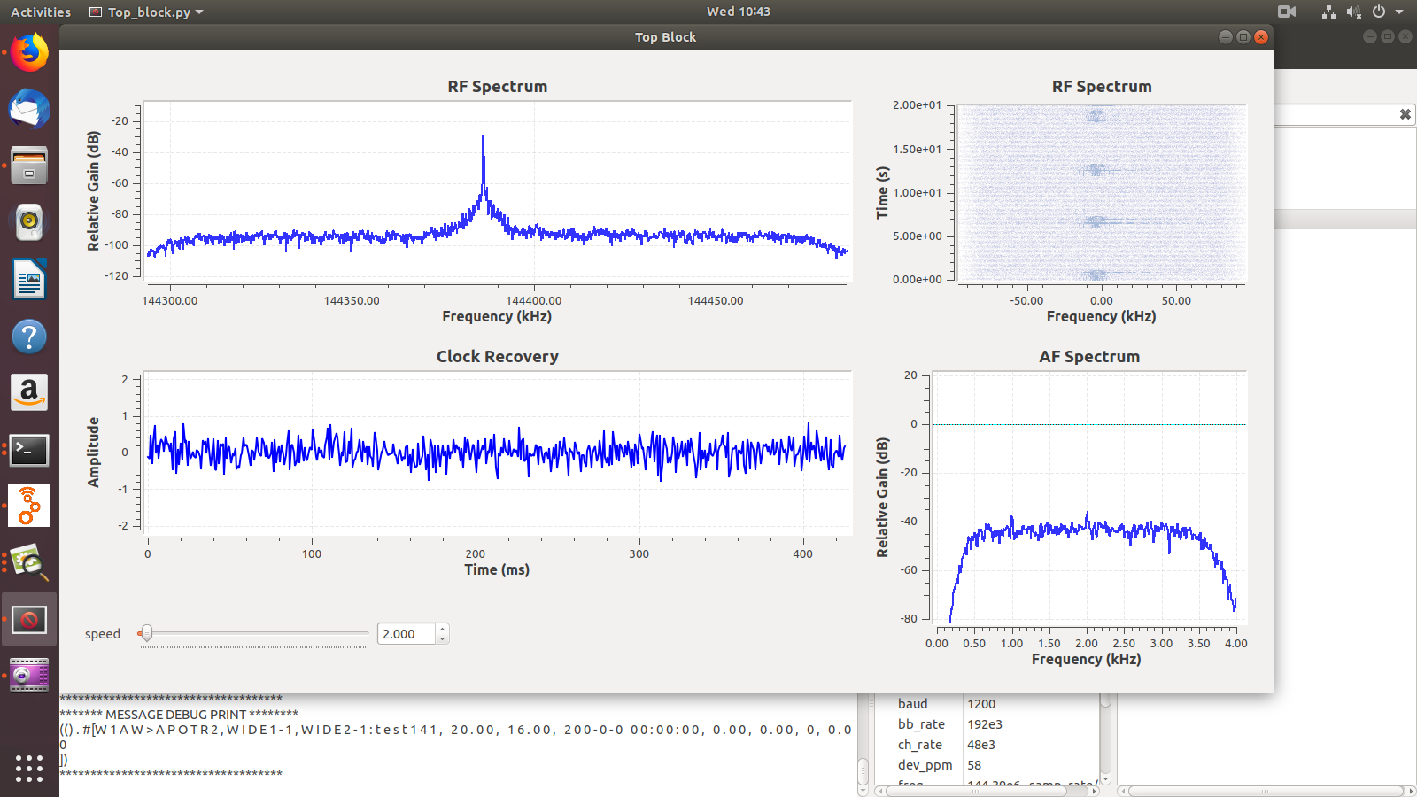
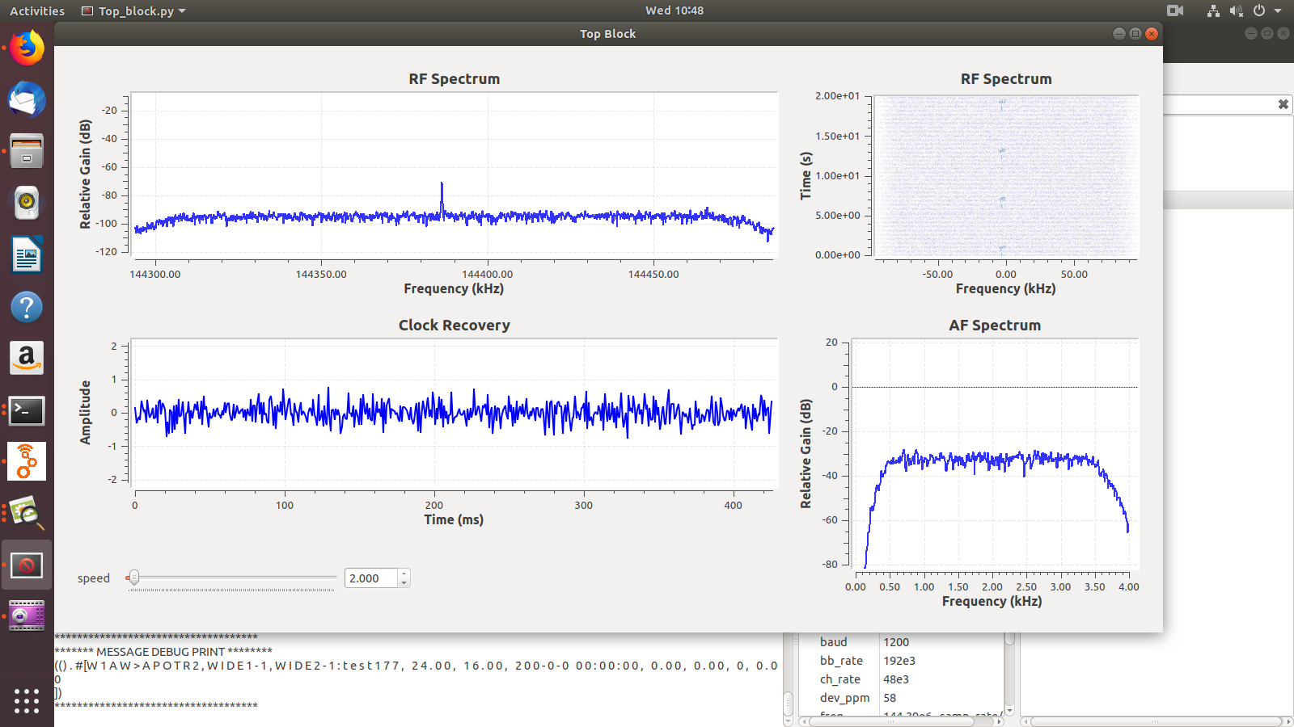
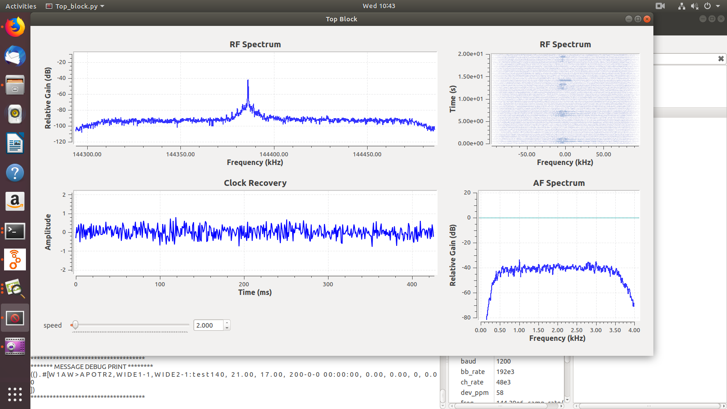
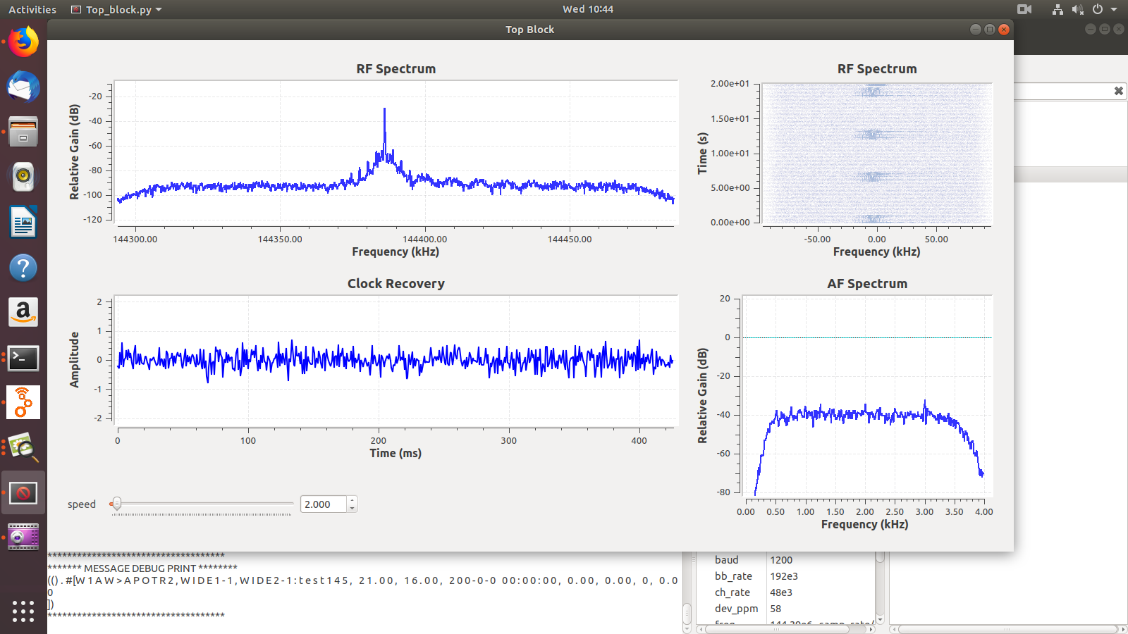
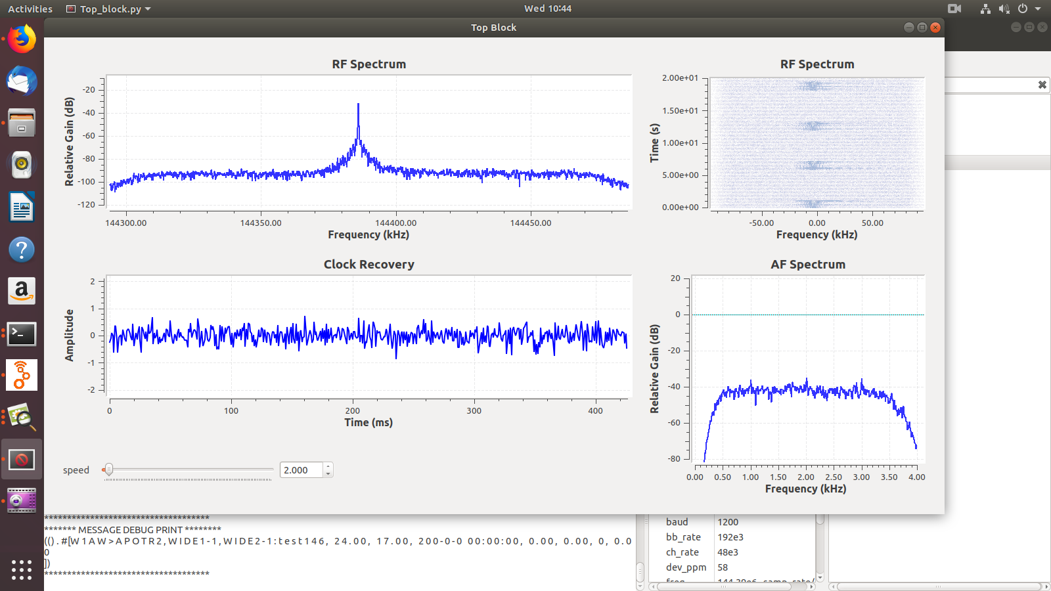
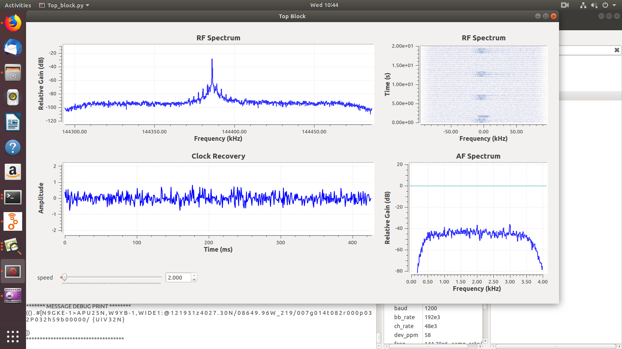

Test-Stability(Strong)
Main
Txt
Color

Slide 31
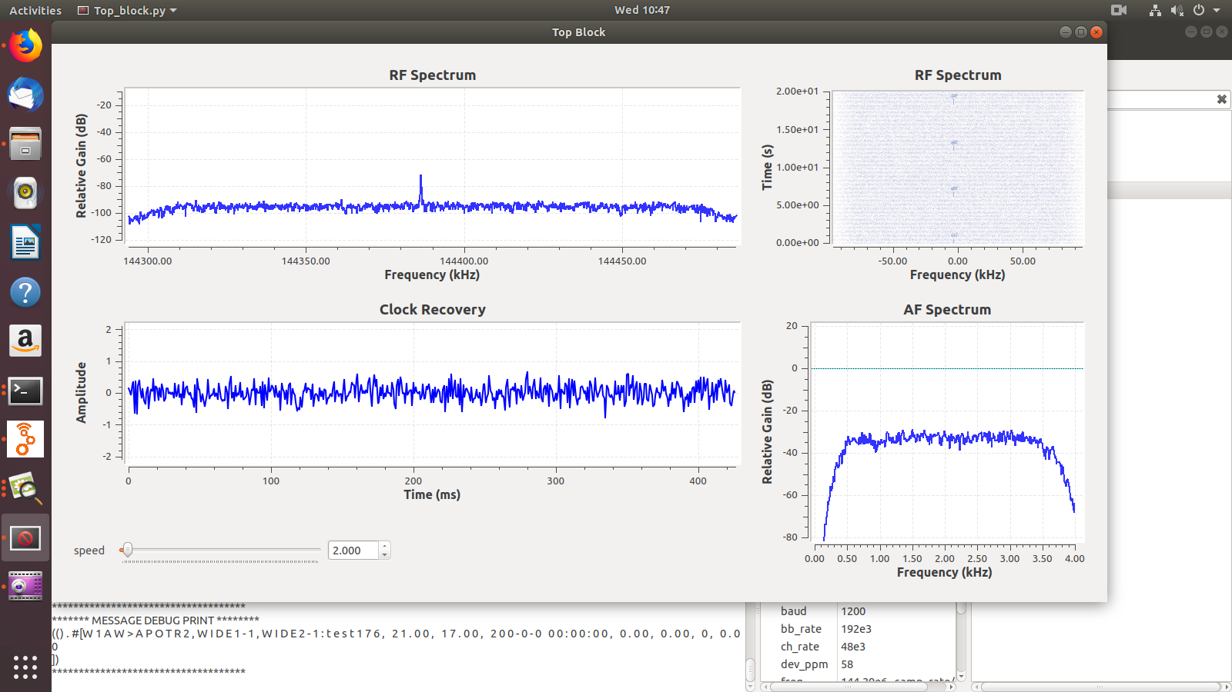
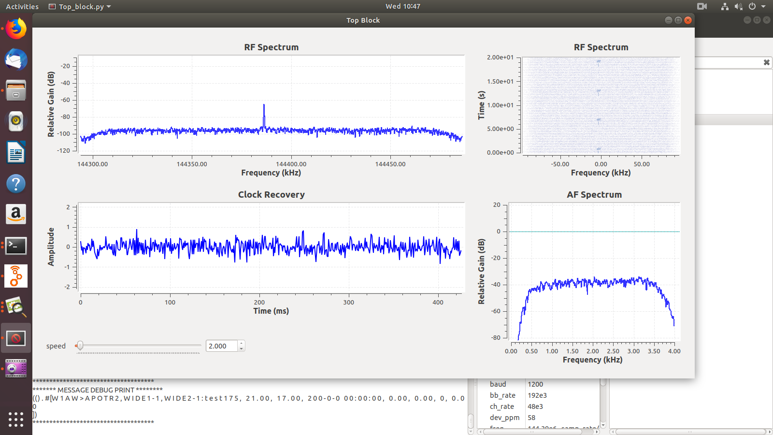
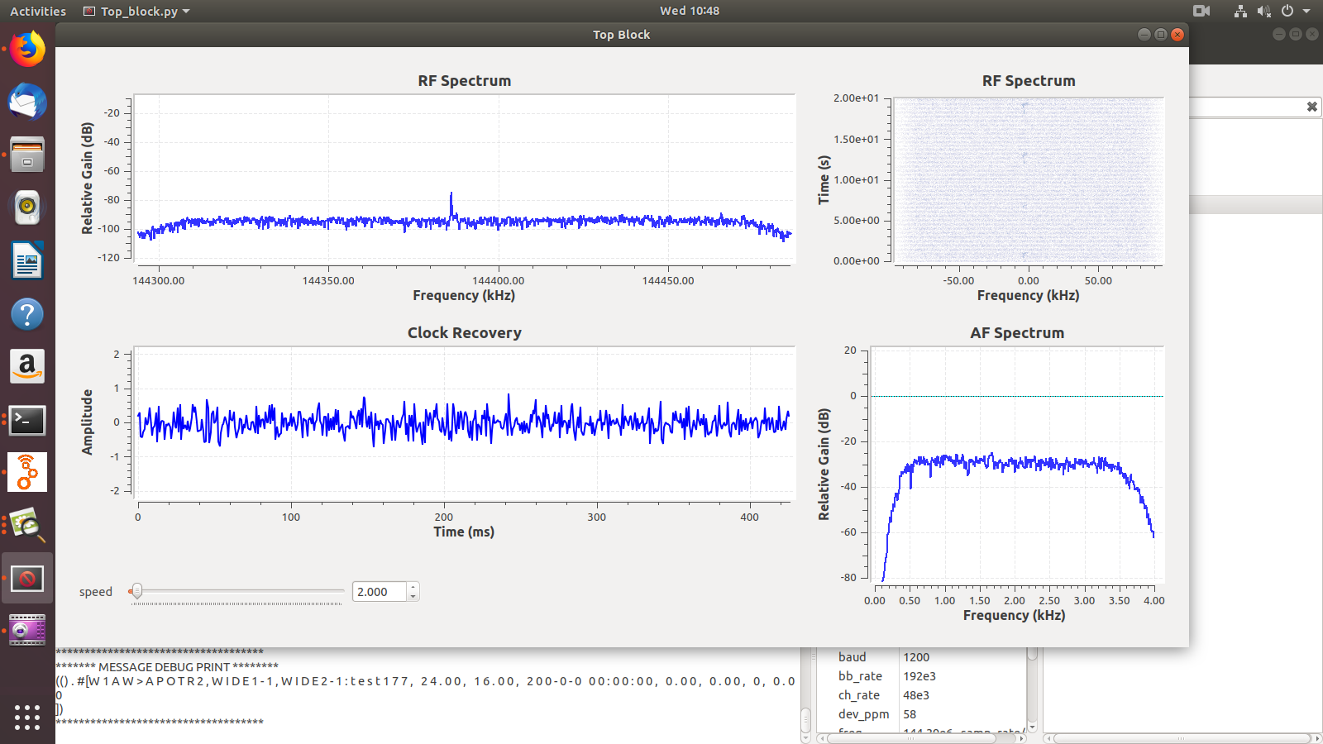

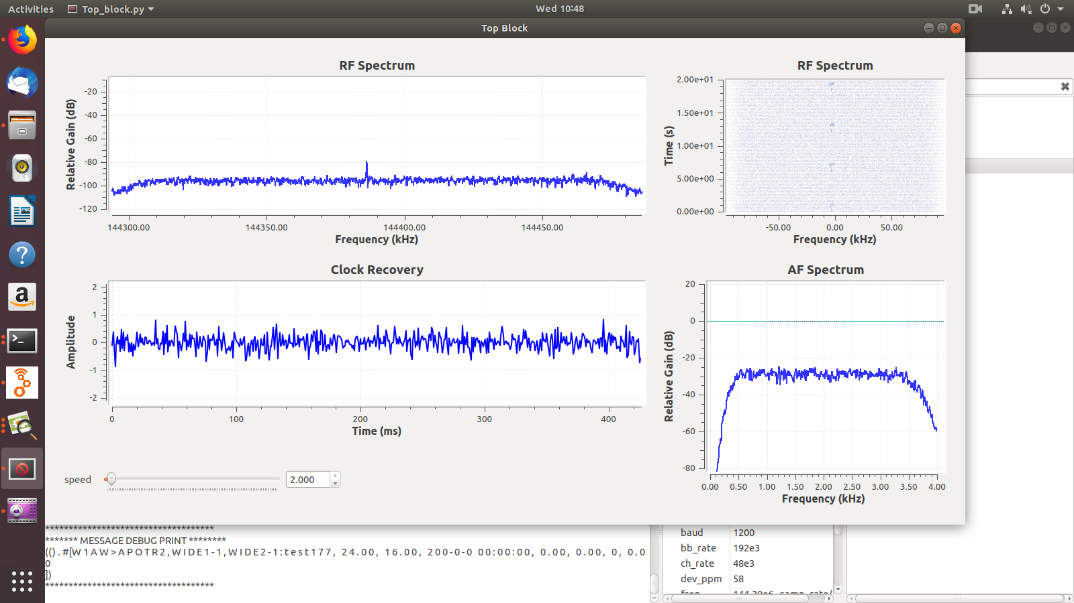
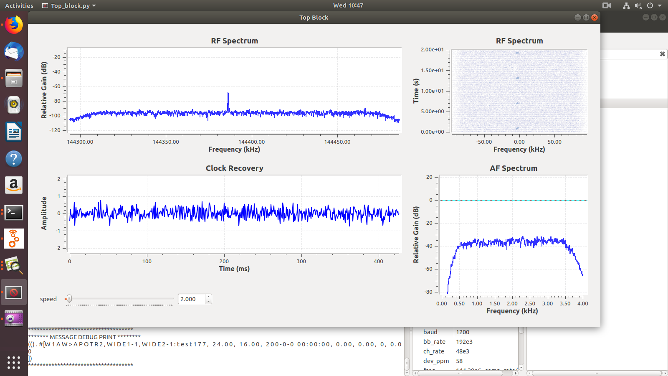
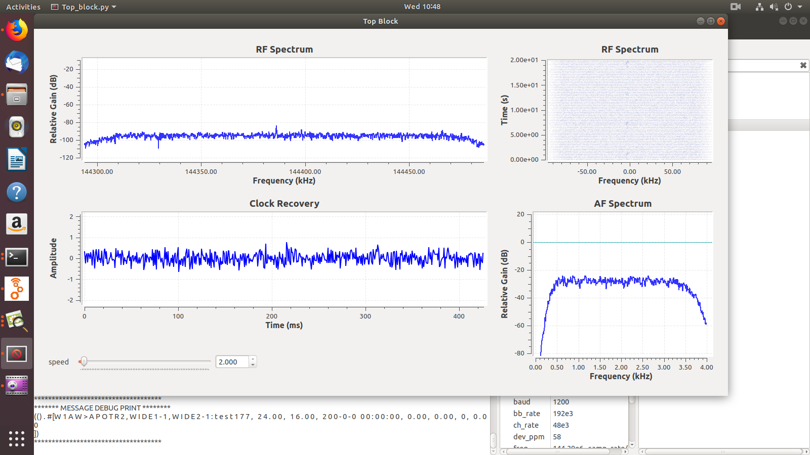
Test-Stability(Weak)
Main
Txt
Color

Slide 32
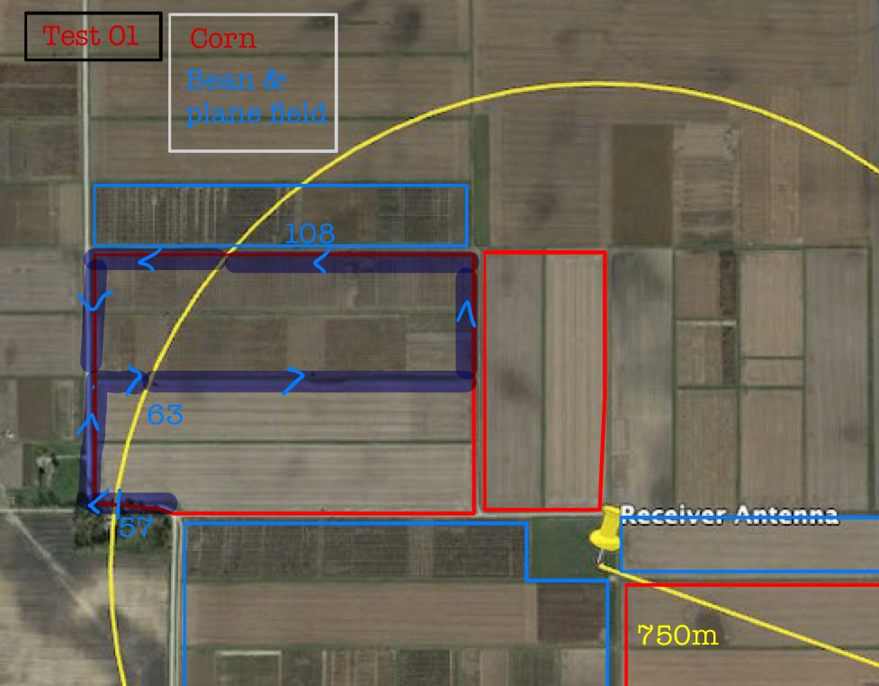
n
Test-Stability
Introduction
Research
Design
&Development
Test
Evaluation
&Conclusion
Future Work
Reference
Main
Txt
Color

Slide 33
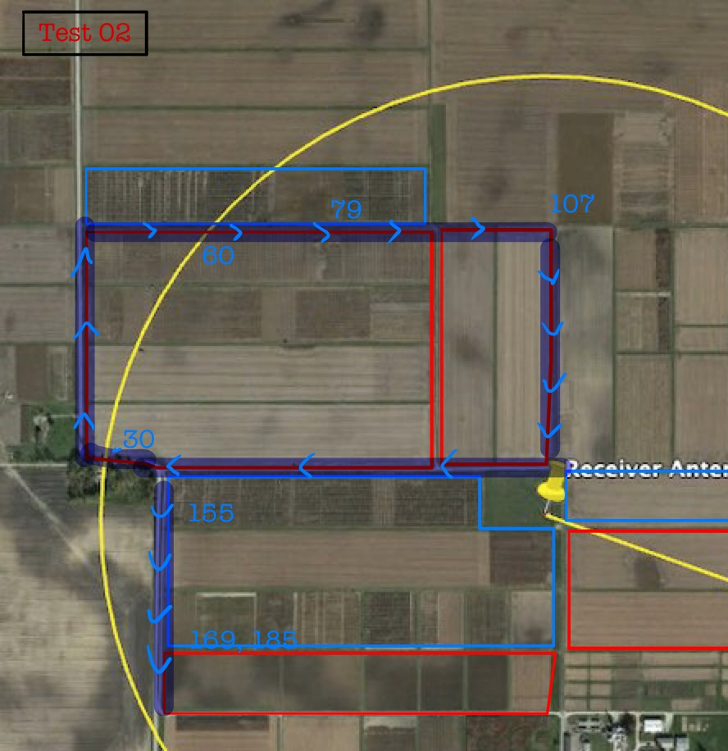
n
Test-Stability
Introduction
Research
Design
&Development
Test
Evaluation
&Conclusion
Future Work
Reference
Main
Txt
Color

Slide 34
n
Evaluation & Conclusion
Conclusion & Evaluation
- Propagation problem has been solved
- Potential Availability of APRS as the adequate network for agricultural IoT has been proved.
- IoT using APRS could be used for other purpose in wilderness environment
Introduction
Research
1.
Propagation problem has been solved
Design
&Development
Test
Evaluation
&Conclusion
2.
Potential of APRS as the adequate network
for agricultural IoT has been proved.
Future Work
Reference
Main
Txt
3.
IoT using APRS could be used for other purpose
in wilderness.
Color

Slide 35
Introduction
Research
Conclusion
33.867cm : 19.05cm
Design
Future work
Development
Reference
n
Future Work
Introduction
Research
Design
&Development
Test
Evaluation
&Conclusion
APRS
(Automatic Packet Reporting System)
Future Work
Reference
Stronger signal power
to transmitter within
the low power
environment.
extend distance
availability by
setting up Digipeaters
Adapt more sensors
that are needed
for AgIoT
Main
Txt
Color
나오며

Slide 36
Reference
https://www.tapr.org/aprs_information.html (APRS description)
To make a circuit diagram, we used a fritzing program.
[1] http://wiki.sunfounder.cc/index.php?title=Humiture_Sensor_Module
[2] https://learn.adafruit.com/adafruit-ultimate-gps/downloads
Vuran, M. C., Salam, A., Wong, R., & Irmak, S. (2018). Internet of underground things in precision agriculture: Architecture and technology aspects. Ad Hoc Networks, 81, 160-173.
Hartono, R., Hasbi, W., Choiriyah, I., & Yatim, R. (2019). Design of APRS Modem Using IC TCM3105 and ATMega2560 Microcontroller. arXiv preprint arXiv:1901.05292.
Hongyim, N., & Mithata, S. (2017, November). Designing and Implementation Exploration Vehicle Remote Controller Using APRS Protocol. In 2017 21st International Computer Science and Engineering Conference (ICSEC) (pp. 1-5). IEEE.
Main
Txt
Color

Slide 37

2019 SUMMER K-SW
AgIOT By Prof. Tony Smith
Q&A
Main
Txt
Color

Slide 38





2019 SUMMER K-SW
AgIOT By Prof. Tony Smith
THANK YOU
Main
Txt
SUKRYUL LIM, CHANGHO SEO, YUNCHANG CHAE Kyungpook Univ.
Supported By
SUMIN LEE Sejong Univ.
CHANHYEOK JUN Jeju Univ.
AIDAN MAIS , AUSTIN RIEGSECKER, MILOS, TOMO, KAR EE HO Purdue Univ.
Color
Prof ANTONY SMITH, Prof ERIC MATSIN, Prof RICHARD GRANT Purdue Univ.

